Slide 1


Hackathon Project COVID-19 HElP
Team Members :
Gaurav
Harsh Agarwal

Slide 2

ABOUT THE PROJECT
The project is basically build to help people in the hard time of COVID19
The aim of the project is to help people reach their destinations during the lockdown imparted by the goverment of India.
Once an individual applies on our site , and the data gets verified and approved by our team , the indiviual would be helped to reach his destination safely..
Visit our website at :

Slide 3





Technologies Used

Slide 4
Overview

Slide 5

HOME PAGE
This is the home page . The user is directed to this page upon successfull login.
The page also contains a little info about covid19

Slide 6
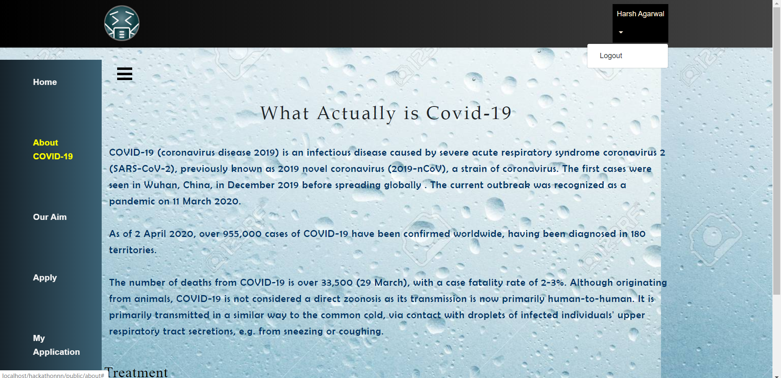
ABOUT COVID19
The page contains a description about covid19 .
It illustrates the problems faced by the individuals in the hard time of covid19

Slide 7
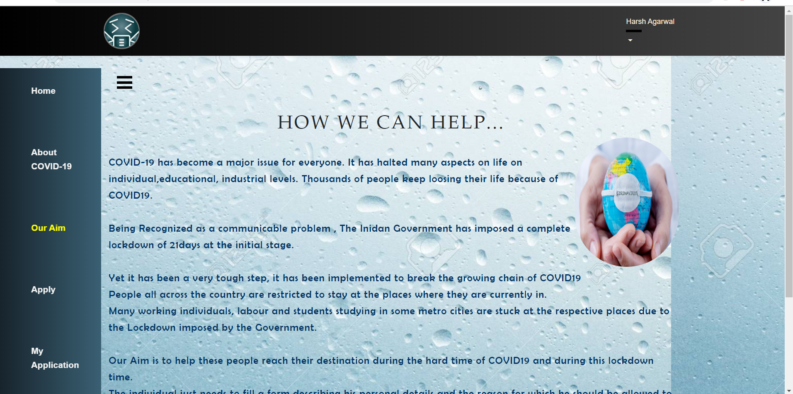
OUR AIM
This page describes our aim of the project.
We aim to help the individuals reach their destination safely during the hard time of COVID19.

Slide 8
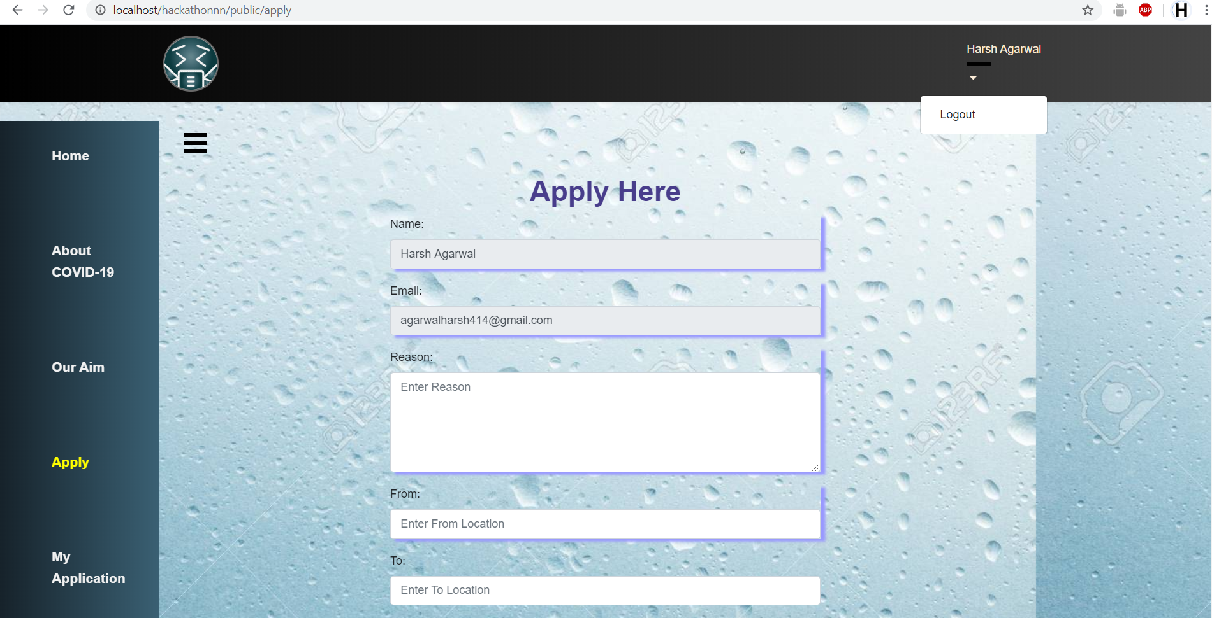
Apply
Through this section or our website,an individual can apply for travel during lockdown .
Our team would approve or reject the application upon verification

Slide 9
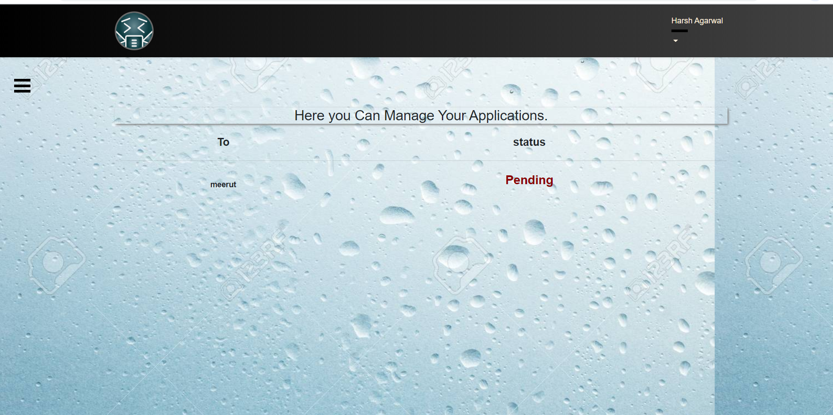
Application Status
This section describes the status of the application submitted through the portal.
Once the application is verified by the team , the status changes from pending to approved or rejected.

Slide 10
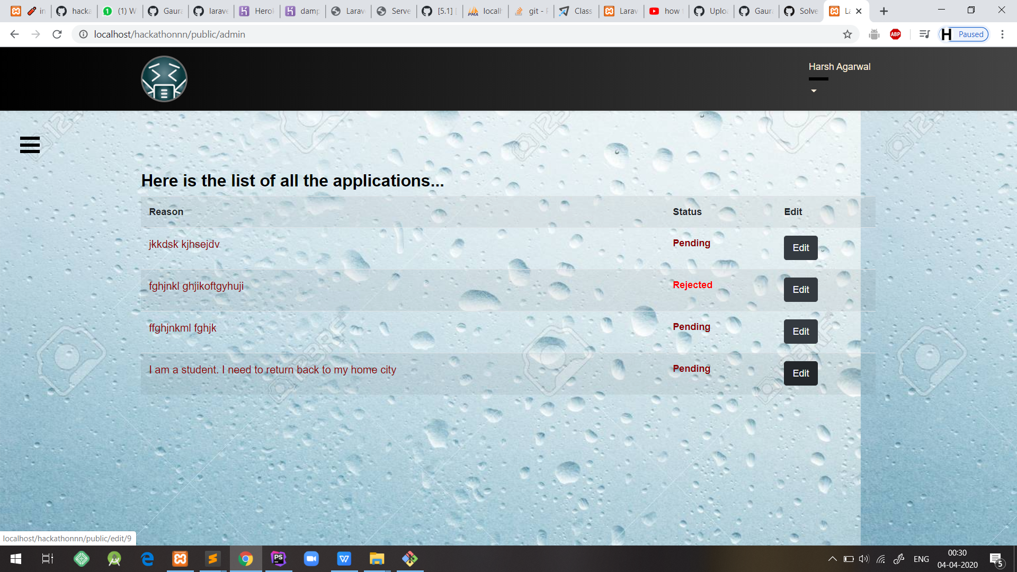
Admin Login
Through this page, the admin can login with his credentials and track all the applications received .
He can perform actions for editing the pending status.

Slide 11
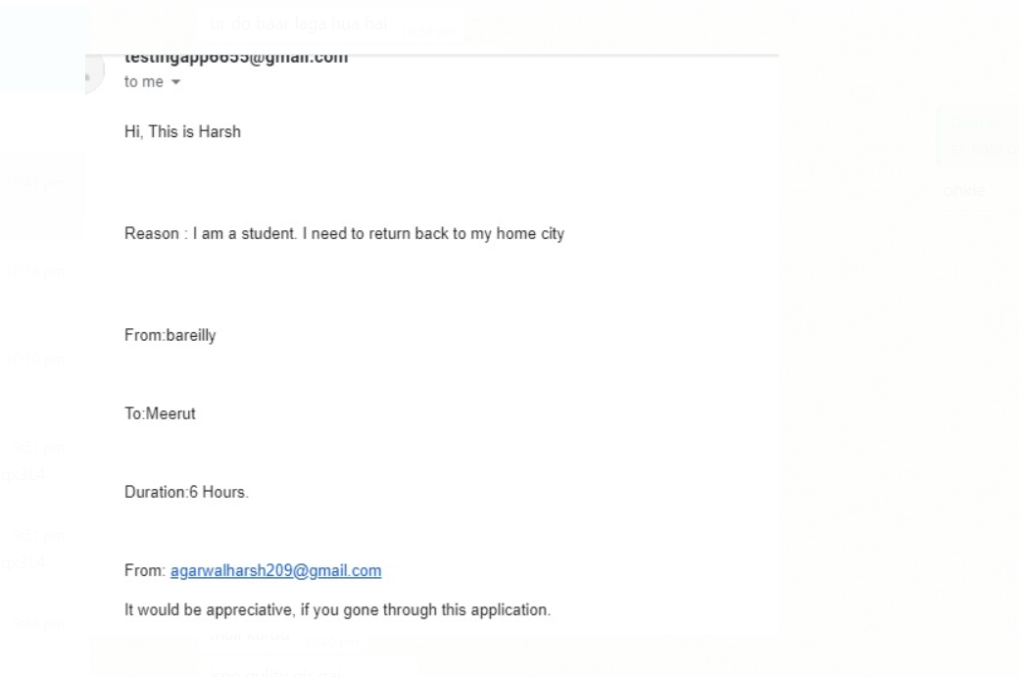
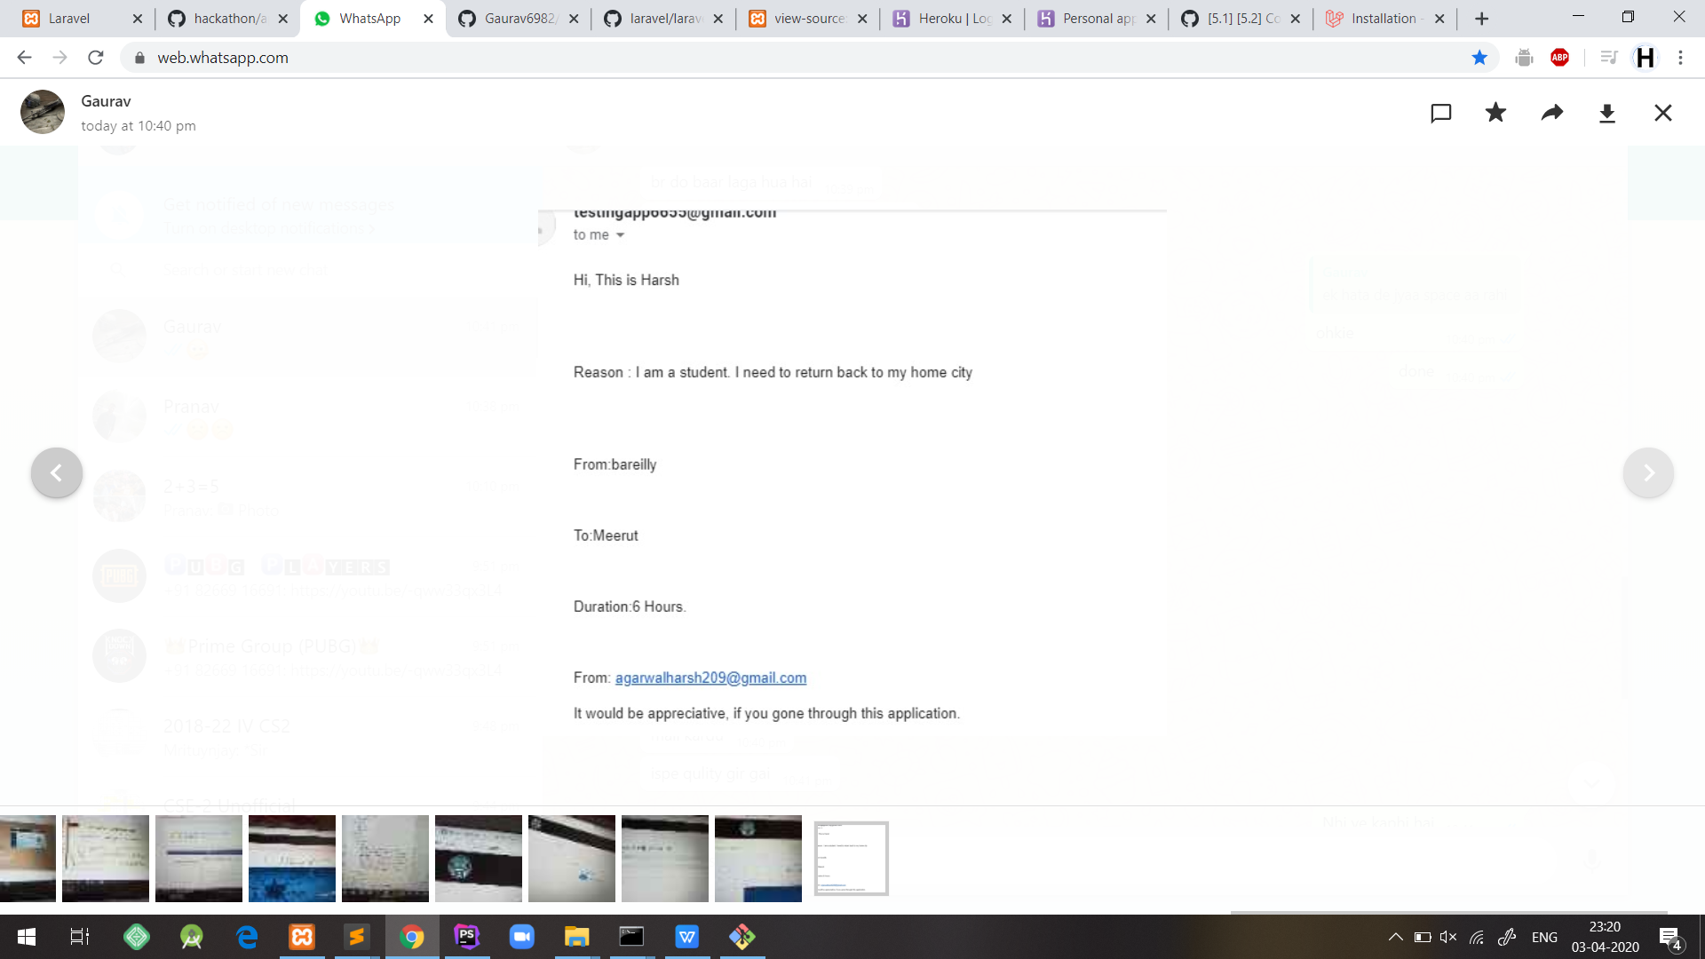
Admin Receives email
For every successfull registraion , the admin receives a email with all the details entered by the registerant.
The team can then accept or reject the application accrdingly.

Slide 12
WHAT ELSE CAN BE ADDED IN FUTURE
A few things could be added to this project in the upcoming time...
A ticket could be generated through the information entered by the registerant during the time of registration.
We could set up a link with the Government of India to allow the approved applicants to reach their destination during the hard-time of COVID19.
The applicant would be required to carry that ticket with him and should take care to reach his destination before the ticket gets expired.

